Slide 1
What's the point
Versionning
Tracking and archiving changes in any set of files
Allowing to retrieve the set of files in any archiving state
Collaborative development
Coordinating work among programmers collaboratively developing source code by allowing non-linear workflows
Every programmer uses a full-fledged repository with complete history and full version-tracking abilities who is independent of network access or a central server

Slide 2




Versionning
index
index
index
TIME

Slide 3
Versionning
index
index
index
TIME
Version control system
Lower memory storage
Faster tracking
Easier retreive
index

Slide 4
What's the point
Versionning
Tracking and archiving changes in any set of files
Allowing to retrieve the set of files in any archiving state
Collaborative development
Coordinating work among programmers collaboratively developing source code by allowing non-linear workflows
Every programmer uses a full-fledged repository with complete history and full version-tracking abilities who is independent of network access or a central server

Slide 5
Collaborative development
SERVER
Remote repo
USER 1
USER 2
Local repo
Local repo
Workspace
Workspace

Slide 6
Collaborative development
SERVER
Remote repo
USER 1
USER 2
USER N
Local repo
Local repo
Local repo
Workspace
Workspace
Workspace

Slide 7

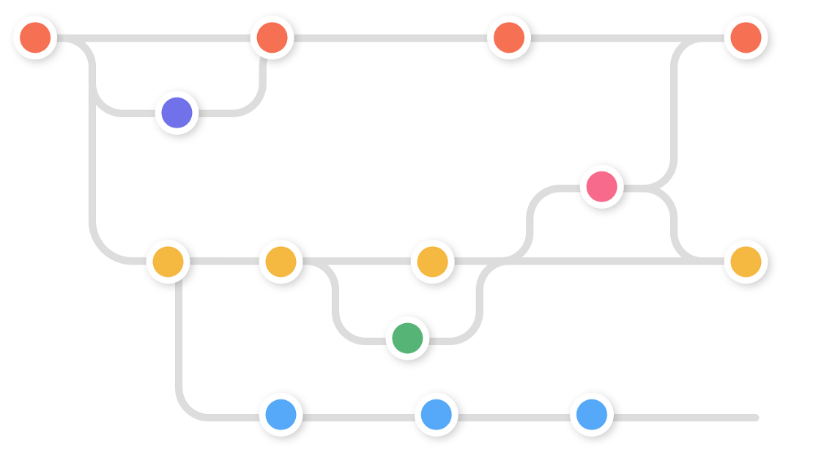
Collaborative development
Project management
Split development by feature, by team, by programmer …
Set non-linear workflow and increase the vision of the project
Switch between branches and optimize the development
image source : nobledesktop / svikashk

Slide 8
What's the point
Versionning
Tracking and archiving changes in any set of files
Allowing to retrieve the set of files in any archiving state
Collaborative development
Coordinating work among programmers collaboratively developing source code by allowing non-linear workflows
Every programmer uses a full-fledged repository with complete history and full version-tracking abilities who is independent of network access or a central server
Git is a collaborative source control management system that has been used in Software Engineering for over 15 years.
It's ubiquitous and used by millions of software engineers around the world

Slide 9
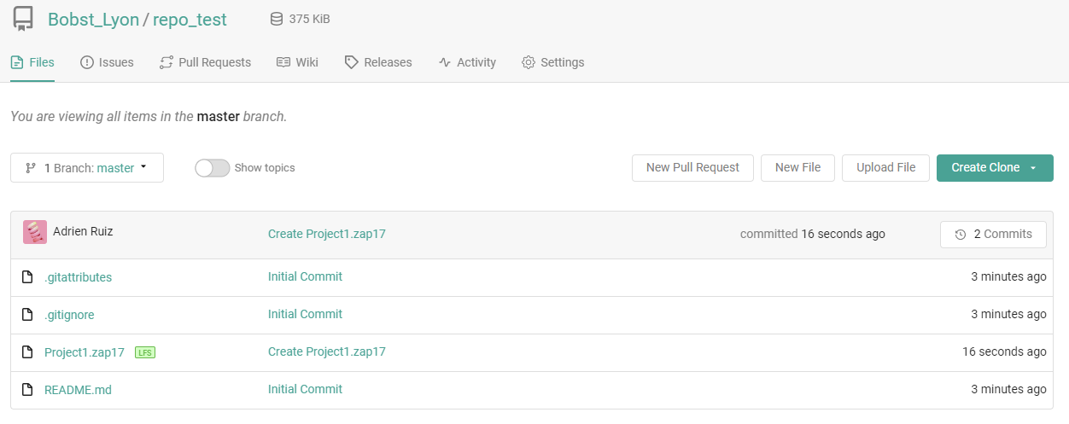
Copia.io
Copia is a complete source control solution designed for controls engineers that makes Git work with industrial code and brings it to industrial automation

Slide 10
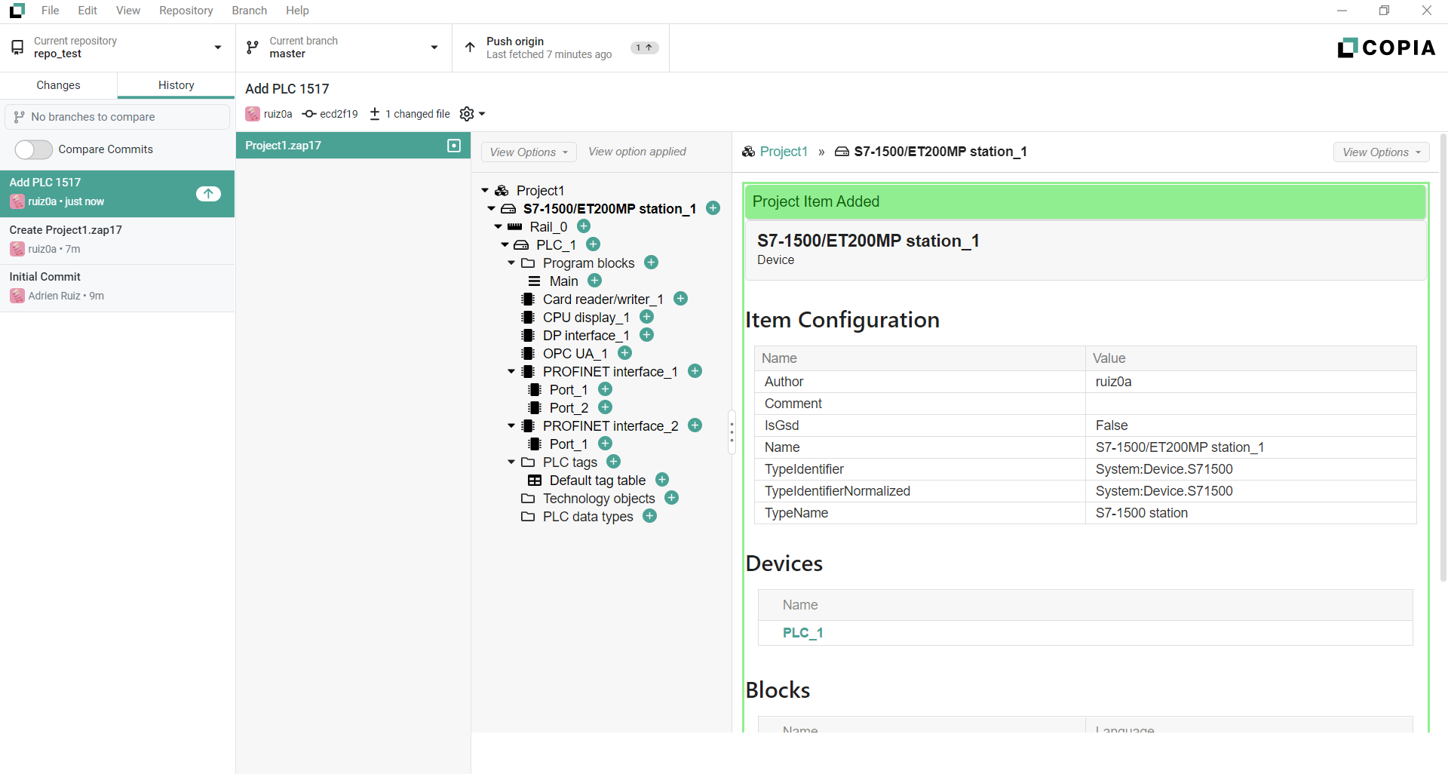
Copia.io

Slide 11
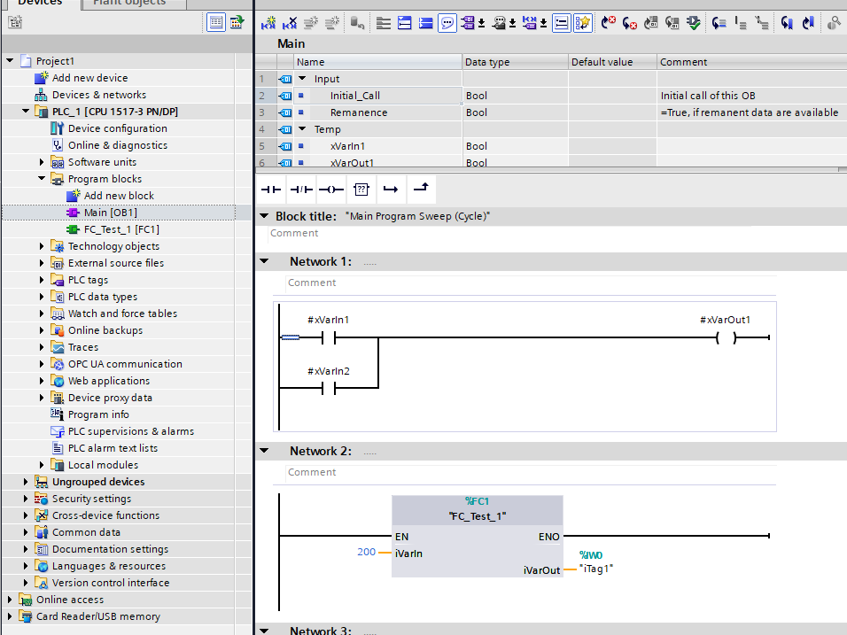
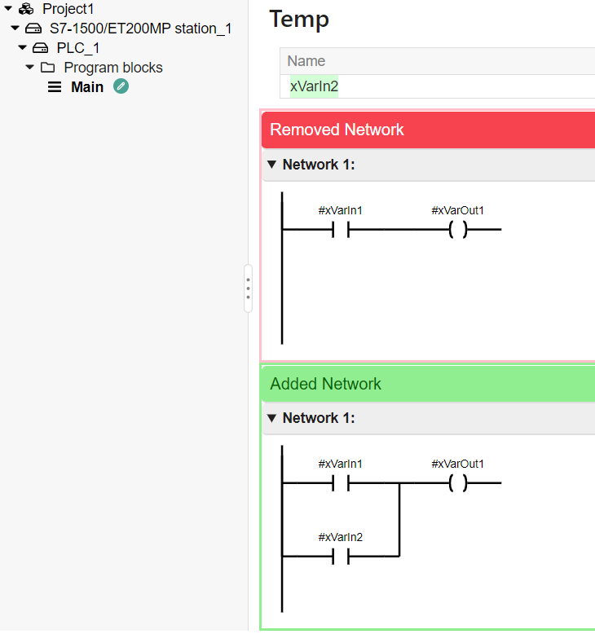
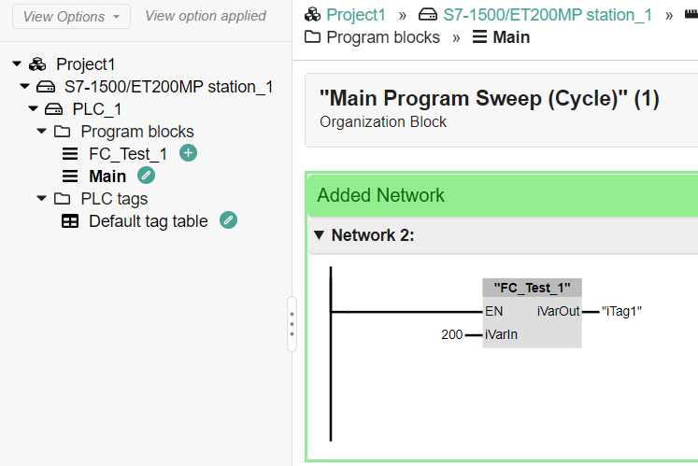
Copia.io

